Slide 1
Summarizing Distributions
Mean, Median
Standard Deviation, Interquartile Range

Slide 2
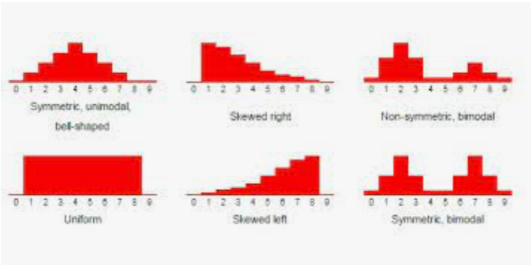
Review: Describing Distributions
Unform distribution
Bell curve
Symmetric
Skewed (left and right)
Bimodal

Slide 3
Today we will review tools for summarizing distributions
Central tendencies of Mean and Median and when to use which one
Range and Standard deviation
Five Number Summary and Interquartile Range

Slide 4
Essential Question
How can I summarize a whole distribution using just a few numbers?

Slide 5
When should I summarize a distribution?
When the summary can accurately portray the distribution as a whole!

Slide 6
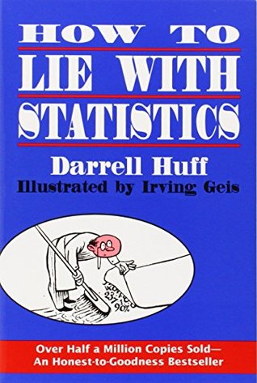
“There are three kinds of lies:
lies,
damned lies,
and statistics”
Mark Twain

Slide 7
Doing math with a different mindset
Algebra
Statistics
The stuff we do in algebra ...
... tells us something insightful
... is hopefully easy to calculate
The stuff we do to summarize distributions ...
... is easy to calculate
... hopefully tells us something insightful

Slide 8
Summarizing Bell Curves
Central tendency: Values tend to cluster
Dispersion: Values are spread out around the central value
Where is the center?
How far is the data dispersed?

Slide 9
Tools for Summarizing Distributions
Central Tendency
Dispersion
Mean
Median
Mode
Range
Standard Deviation
Interquartile Range (IQR)

Slide 10
Calculate the Mean and find the Median (Center)
Mean: $\frac{Add the data}{The number of pieces of data}$
We sometimes use $μ$ (mu) as shorthand for the mean
Median: Put the numbers in numerical order and find the number in the middle. If there is an even number of data, find the mean of the middle two numbers.

Slide 11
Spread/Variation
Range: The difference between the largest and smallest number. This is a single number, not an interval.
Standard deviation: The average distance each piece of data is from the mean
We sometimes use $σ$ (sigma) as shorthand for the standard deviation

Slide 12
Calculate the Range
Maximum - Minimum

Slide 13
Use your calculator to find the standard deviation
$Stat→1:Edit$Enter the data into L1. If you have data in the list already, use the arrow keys to highlight L1$→clear→enter$
$stat→CALC→1:1−Var Stats→L1 \left(or whatever list you used if you used a different one, the calculator defaults to L1\right)→Calculate\left(leave FreqList blank\right)$
$\overline{x}$read as x-bar, is the mean
Sx is the standard deviation
Continue to scroll down and you will see Q1 and Q3 so you can find the Interquartile Range (IQR)

Slide 14
What if the distribution is skewed?
What should the center of this distribution be? Are there multiple valid opinions? Does your definition of the center also change your definition of dispersion?

Slide 15
A Different Strategy
Take the data set, put the values in ascending order, and divide into groups. Then, to summarize the distribution, look at the numbers between the groups.
1 | 3 | 3 | 5 | 6 | 9 | 11 | 12 | 15 | 15 | 19
1 | 3
3
5 | 6
9
11 | 12
15
15 | 19

Slide 16
Quantiles
Quantiles are cut points that divide the data into equal-sized intervals.
Name | Number of Intervals
Median | 2
Quartile | 4
Decile | 10
Percentile | 100
1 | 3 | 3 | 5 | 6 | 9 | 11 | 12 | 15 | 15 | 19
Q1
Q2
Q3
The data above has been split into quartiles: four groups, three cut points.

Slide 17
Interquartile Range (IQR)
Range of the middle half of the distribution, from the first quartile to the third quartile:
Interquartile Range
1 | 3 | 3 | 5 | 6 | 9 | 11 | 12 | 15 | 15 | 19
Range

Slide 18
Calculating Ranges
Interquartile Range
Range
Range of the middle half of the distribution, from the first to third quartile
$$Q3 −Q1$$
Range of the entire distribution
Max $−$ Min

Slide 19
5 number summary
Minimum, Q1, Median (Q2), Q3, Maximum
1 | 3 | 3 | 5 | 6 | 9 | 11 | 12 | 15 | 15 | 19
Measure of center: Median (Q2)
Measures of dispersion: Range (max – min) IQR (Q3-Q1)

Slide 20
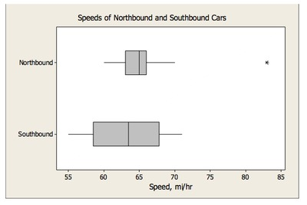
Visualizing 5-number summaries: Box plots
https://tasks.illustrativemathematics.org/content-standards/tasks/1027

Slide 21
Rule of thumb
When should we use mean or median as our center?
Mean is often used when the data is symmetrical
Median is often used when the data is skewed, why?
When we use mean as the center, we use standard deviation to describe the spread since the calculation of standard deviation is based on the mean.
When we use median as the center, we use IQR to describe the spread since IQR is calculated using the 5 number summary.

Slide 22
Homework
Worksheet, see Teams

